Slide 1
Your (Inevitable) Journey to the Cloud…
…and better security
Mark Weatherford
vArmour
Chief Cybersecurity Strategist

Slide 2
Cloud computing is…“a sea change - a deep and permanent shift in how computing power is generated and consumed. It’s as inevitable and irreversible as the shift from steam to electric power in manufacturing, which was gaining momentum in America about a century ago.”
- Andrew McAfee, Harvard Business Review, November 2011

Slide 3
Cloud-based products and services are growing across the board and more than 86% of all workloads will be processed by cloud data centers by 2019.
- Cisco Cloud Index 2015
Bezos’ Law: “Over the history of Cloud Computing, a unit of computing power price is reduced by 50 percent approximately every three years.”
- Greg O’Connor, CEO, AppZero

Slide 4
The IT world is shifting from physical infrastructure to digital and software-defined technologies…

Slide 5
And the shift is having a profound effect on the core infrastructure of the data center and the cloud

Slide 6
Software Defined Everything (SDx)
Compute
Storage
Networking
Security
Software Defined Computing (virtualization)
Software Defined Storage (SDS)
Software Defined Networking (SDN)
Software Defined Security
Evolution of the Software Defined Data Center (SDDC)

Slide 7
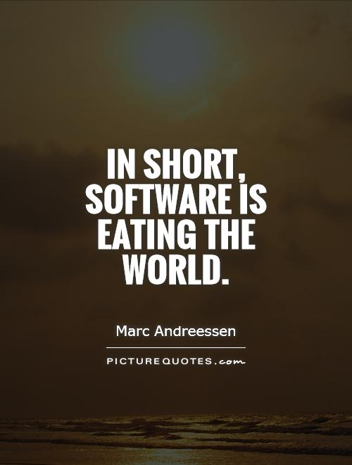
“The era of separating traditional industries and technology industries is over, and those who fail to adopt right now will soon find themselves obsolete.”
- Forbes.com

Slide 8



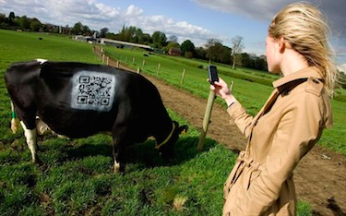
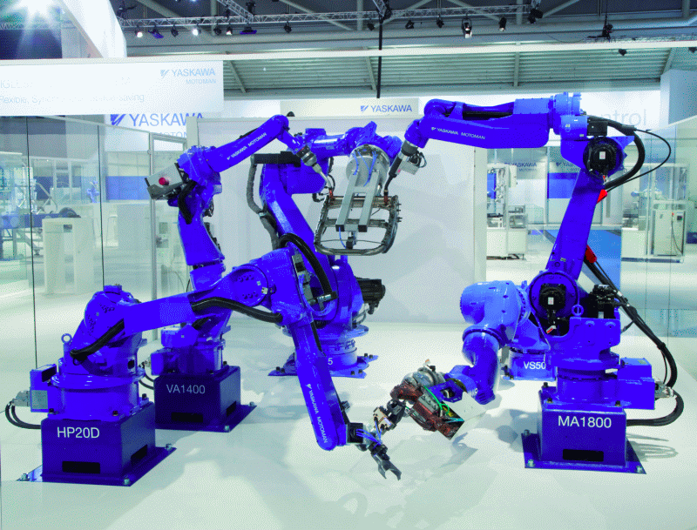
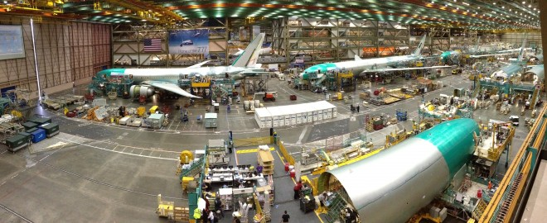
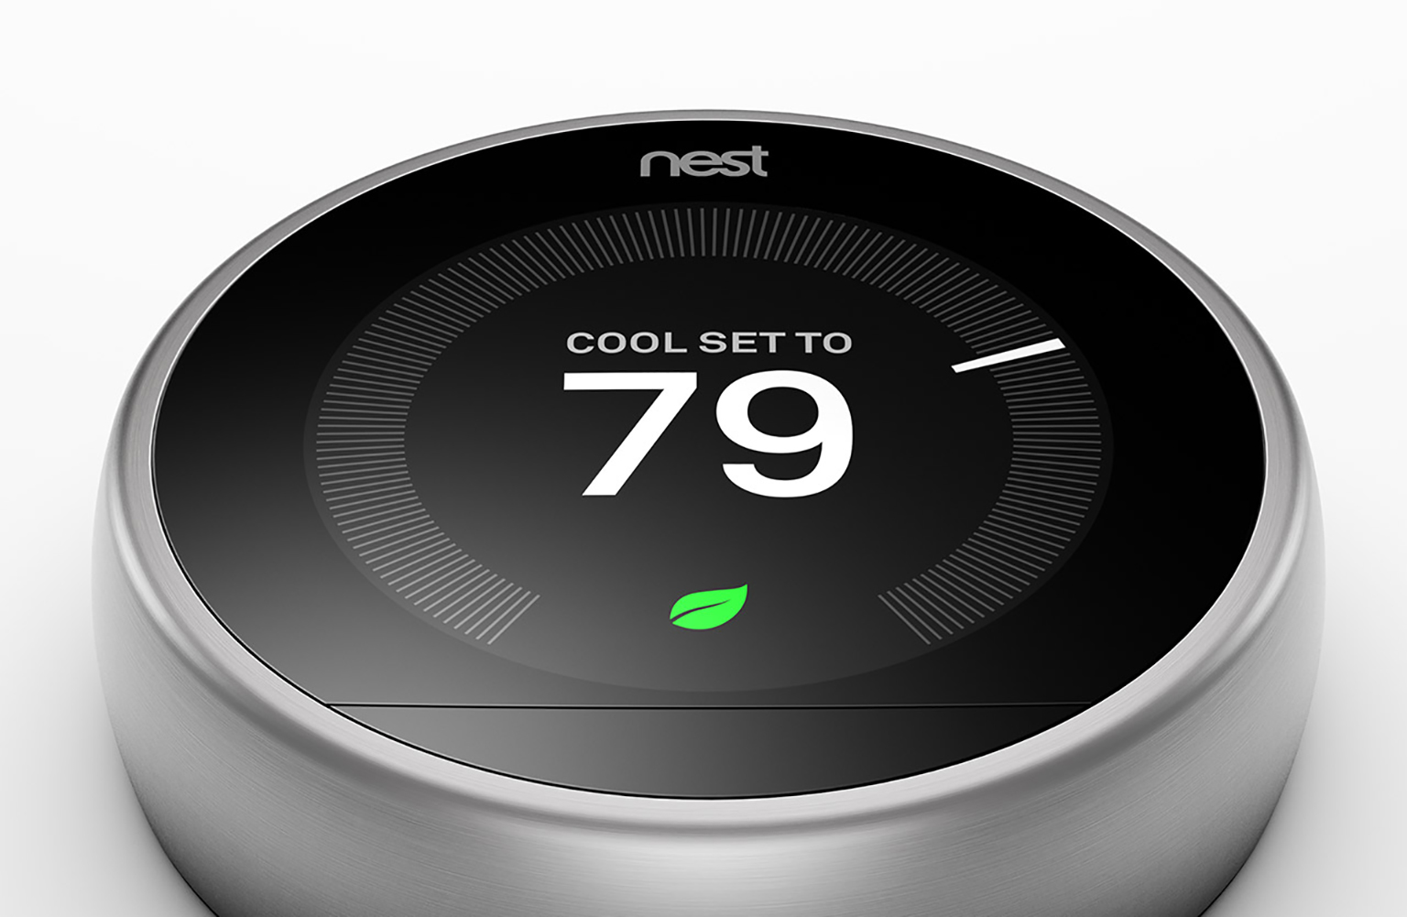
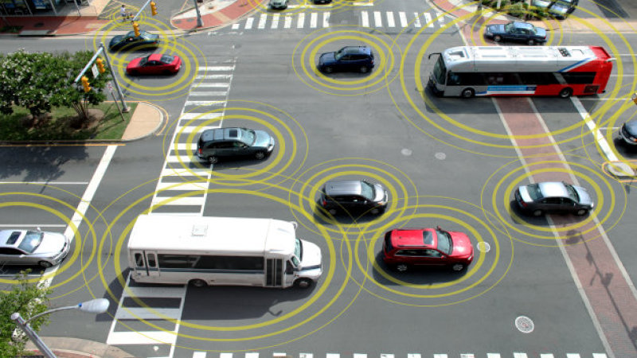
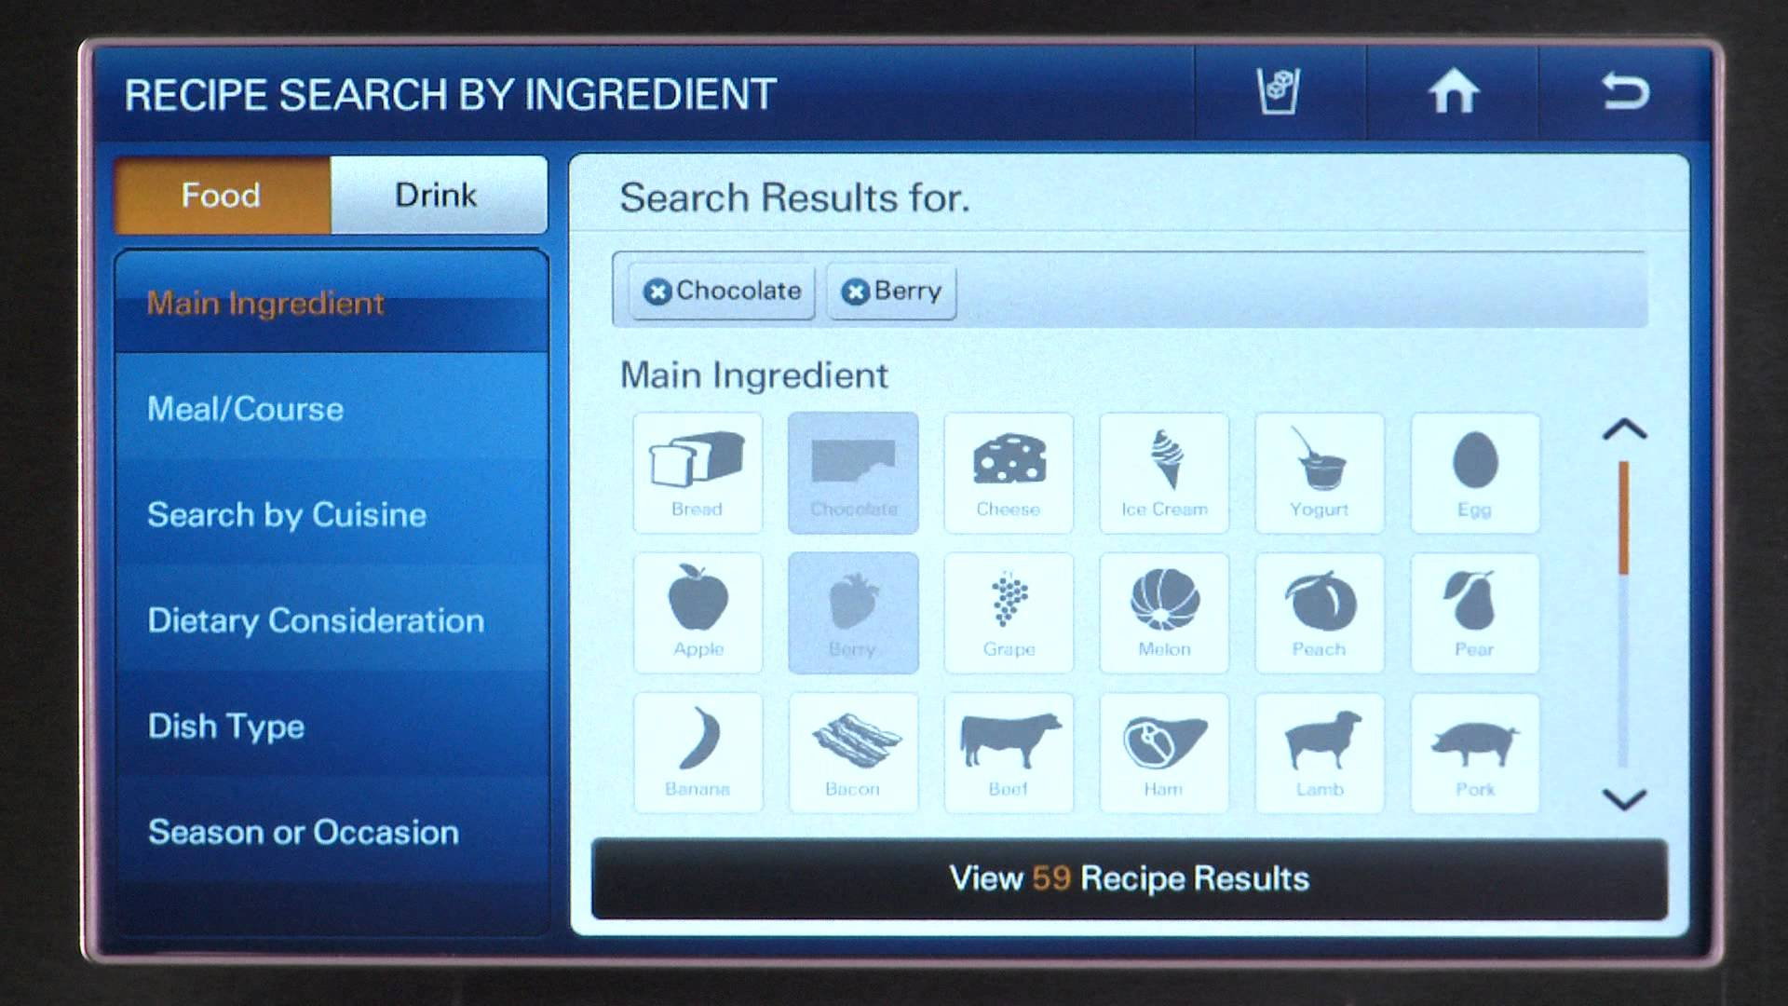



New products and services depend on the cloud

Slide 9
Public vs hybrid cloud strategies are changing
Use of public cloud up 43.3% since 2011
Use of hybrid clouds up 19.2% since 2011
Use of private clouds down 48.4% since 2011
Wikibon/North Bridge Ventures 2015 Future of Cloud Computing Survey

Slide 10
SaaS is the most highly deployed cloud service
Cisco Global Cloud Index 2014-2019

Slide 11
IT and business operations are moving
85.9 percent of web content management
82.7 percent of communications
80 percent of app development
78.9 percent of disaster recovery
81.3 percent of sales and marketing
79.9 percent of business analytics
79.1 percent of customer services
73.5 percent of HR & Payroll activities
Wikibon/North Bridge Ventures 2015 Future of Cloud Computing Survey

Slide 12
CAPEX vs OPEX
Static investment vs. dynamic investment
Lower costs, more flexibility and easier to scale
Less dependency on legacy infrastructure
Pay for only the capacity you need, when you need it
Transfer some of the IT risk to the cloud provider

Slide 13
We live in a multi-cloud world
Physical
Virtual
Cloud
Multi-Cloud
Notes:
The world is being transformed by software and digital systems, and this transformation is having profound effects on all areas of Information Technology.
Transforming from basic virtualization → multi-cloud.
At vArmour, we believe we are currently at the forefront of the related transformation of data center security into a set of distributed, dynamically deployable services providing holistic controls for the entire distributed processing environment, or Multi-cloud. In this Webinar, I will present the the vision we have created, working with our customers, partners and key industry analysts, for Datacenter Security in a Multi-Cloud World.
Before we start, I just want to clarify the term ‘multi-cloud’.
Multicloud addresses the emerging business demand to leverage a mix of the many ‘best of breed’ cloud services platforms to provide an optimal IT solution.
It provides single brokered, risk managed computing resource consisting of multiple unrelated venues.
A multi-cloud might include public cloud, 3rd party hosted, and private datacenters offering up resources with varying properties and service levels. Those resources might include various flavors of PaaS and IaaS services through to physical devices.

Slide 14

But…is it safe?

Slide 15
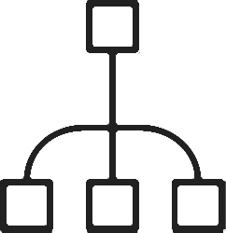
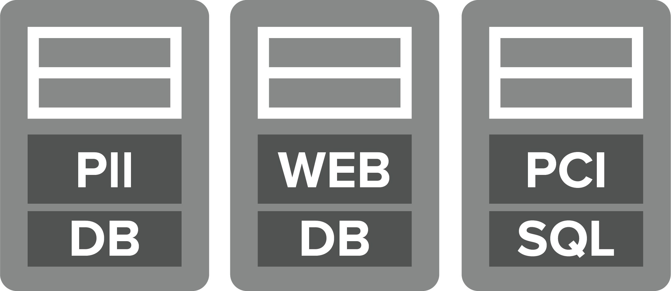








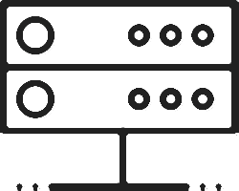
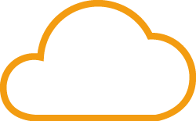


The perimeter is dead, long live the cloud
Perimeter Controls
Load Balancers
Digital Partners
Internet
Insider Threats
Firewall
Virtual
Mobile
BYOD
Users
IPS
Physical
Public Cloud
Cloud
IoT
Web Application Firewall

Slide 16
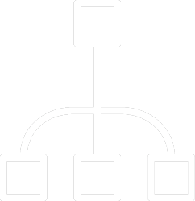



80/20 rule for data center and cloud traffic
Inbound/Outbound
Traffic
Only 20% of traffic is inspected by traditional perimeter security solutions
Load Balancer
Firewall
IPS/IDS
DLP
Web Application Firewall

Slide 17
80% of data center traffic isn’t screened by perimeter controls for suspicious/ unauthorized behavior or application misuse.
East-West
Internal Traffic

Slide 18

…we’re blind inside the cloud
Most companies aren’t instrumented for east-west traffic visibility inside their virtual data centers and cloud so they see very little of the actual data communications

Slide 19


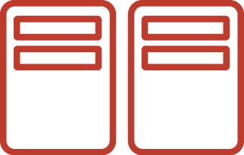


Security challenges and opportunities
Separation of assets:
Micro-Segmentation
Visibility and
monitoring of applications and users
Detecting and mitigating
APTs and
insider threats
Investigating security incidents Incident Response and
Forensics
Managing security across
Multi-Cloud Environments

Slide 20
Shadow IT in the cloud
…worse than you think

Slide 21
AWS responsibility boundaries
Customer Data
Applications
Identity & Access Management
Distributed Security System
Your company
Operating System & Network
Foundation Services
Compute
Storage
Database
Network
Amazon
Availability Zones
AWS Global
Infrastructure
Edge Locations
Regions
Your company
AWS

Slide 22
The cloud is a catalyst for better security
Adoption of cloud applications and services is accelerating - not because you don’t know what or how to do it but because:
The economic advantages are profound
The cloud provides anywhere/anytime access
Offers high reliability and automatic backups
Better resourced, with around-the-clock support
Cloud providers are highly incentivized to deliver security - they are paranoid by default

Slide 23
Ask the wrong question, get the wrong answer
1. What kinds of data centers (Tier 1/2/3) does the cloud provider use?
2. What is your cloud provider’s disaster recovery plan?
3. What compliance certifications does the cloud provider have?
4. What are the cloud provider’s encryption policies?
5. How is my data isolated from other clients’ data?
6. Can I use my existing IAM software to control cloud access?
7. How is activity in my account monitored and documented in log files?
8. Can I visit a data center and do my own inspection?
9. What must I know in case I decide to change cloud providers?
- Stephan Lawton in Tom’sITPro

Slide 24
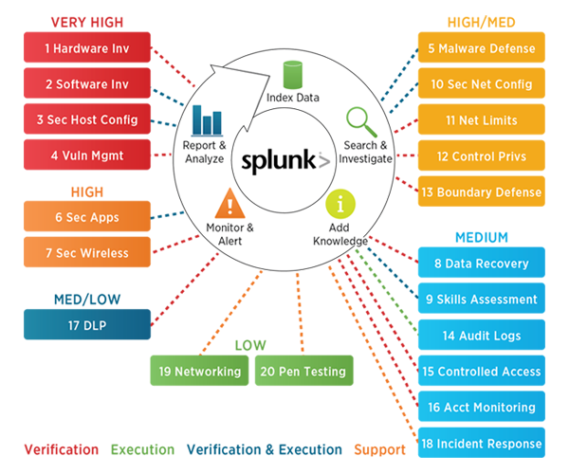
Top 20 Critical Controls
Top 20

Slide 25
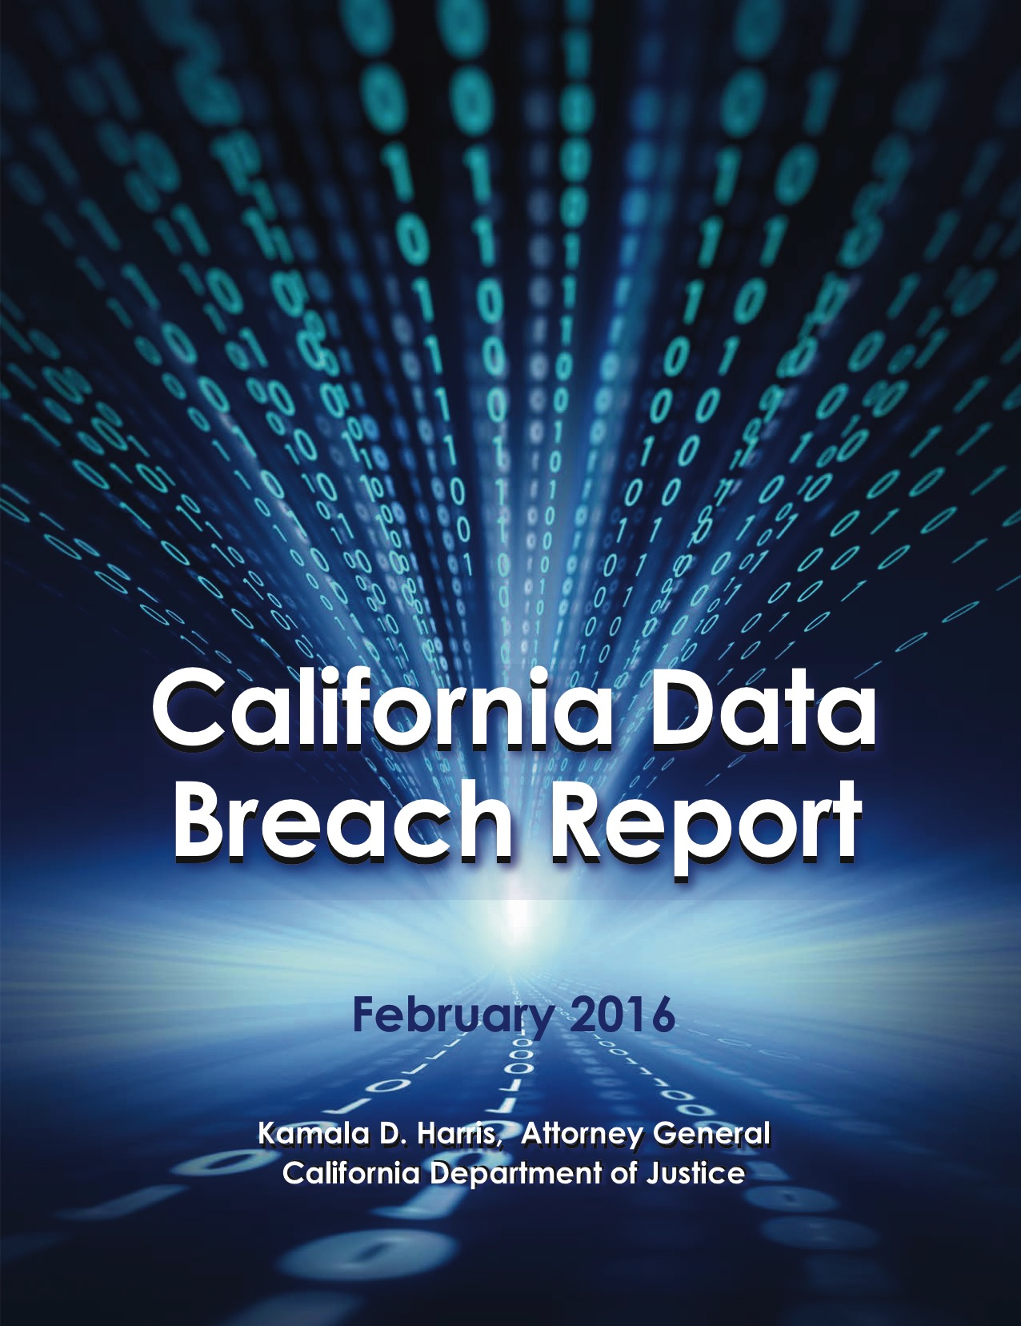
Top 20 Critical Controls

Slide 26
Top 20 Critical Controls
- getting some teeth!
1) The 20 controls in the Center for Internet Security’s Critical Security Controls identify a minimum level of information security that all organizations that collect or maintain personal information should meet. The failure to implement ALL (emphasis mine) the Controls that apply to an organization’s environment constitute a lack of reasonable security.
Recommendations

Slide 27
Just because you’re
PARANOID
it doesn’t mean
they’re not out to get you

Slide 28
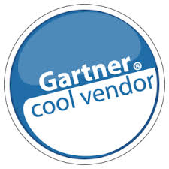
Mark Weatherford
mark@varmour.com
@marktw

